Slide 1
RECOMMENDATION SYSTEM WITH MACHINE LEARNING & DEEP LEARNING - Final Presentation
Data 606 Capstone Project
By Kam Hin Ho

Slide 2

Introduction
The more accurate recommendation the system provides, the user tends to interacts with the recommendation → more Revenue
Collaborative Filtering is a method of making automatic prediction/recommendation about the interests of a user by collecting preferences or taste information from many users.
This project has explored the implementation of Singular Value Decomposition (SVD), SVD++, and Neural network-based Collaborative Filtering (NCF) in recommendation system.

Slide 3

Dataset
The dataset was obtained from GroupLens Research from their MovieLens website.
There are about 25 millions of 5-star rating with over 1 million tag applications across 60,000+ movies
The rating data is created by around 160,000 users between 1995 to 2019.
Rating.csv is mainly used in this project. (User ID, Movie ID, and Ratings)
Features: User ID, Movie ID
Target Variable: Ratings
Due to the resource's limitation, 20% of the dataset was used in this project. (About 5.5+ million data)

Slide 4
Methodology - SVD, SVD++
Surprise Library was used
SVD and SVD++ algorithm
SVD: a way to factorize a matrix into singular vectors and singular values which let us reduce the data in machine learning.
SVD++: an extension of SVD that taking into account implicit ratings. An implicit rating describes the fact that a user rated an item, regardless of the rating value.
80/20 split for training and testing.
Cross Validation was performed to reduce overfitting.

Slide 5
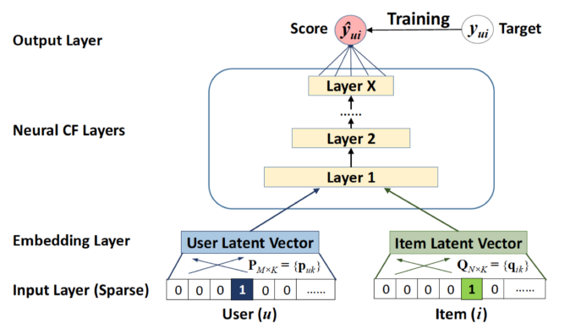
Methodology - NCF
Pytorch_lightning library was used
Generated synthetic negative samples for the implicit data.
Then, we fed the user input vector and item input vector to the user embedding and item embedding respectively
→ A smaller & denser user and item vector
Neural CF layers use multi-layered neural architecture to map the latent vectors for prediction.
The embedded user and item vectors are concatenated before passing through a series of fully connected layers, which maps the concatenated embeddings into a prediction vector as output.
The final output layer returns the probable class using Logistic Sigmoid Function.

Slide 6
Results
Performance & Accuracy:
NCF took the longest time to train and test yet it provides the best accuracy in its prediction.
→ Computation Cost is relatively higher but result in better recommendation.
The SVD has a faster training time , but slower testing performance. In contrast, SVD++ has a relatively longer training time, but faster testing performance. In terms of accuracy, SVD has a lower/better RMSE than SVD++.
→ Moderate Computation cost but moderate prediction accuracy

Slide 7
Limitation and Further Work
Limitations:
The Movie Lens data has lacked implicit data such as the user interaction record of the movie items. As the NCF model requires implicit data, we must generate the synthetic data for the negative samples in order to have a comprehensive dataset.
Lack of computing resources, which leads to performance issue and limited data on model training and testing.
Due to the time limitation, we didn't have the time to explore the FAISS model.
Further work & Improvements:
We would like to get e-commerce data that has users, products, item ratings, and interaction records, and fit the new dataset to the model. It is important to see if this model can be implemented across different industries where collaborative filtering is needed for recommendations.
It is predicted that the performance and processing capabilities will be improved if we have more resources available, such as more CPUs, RAMs, and GPUs.
Investigate and Explore the performance and accuracy of FAISS, and compare the result to the rest of the models.

Slide 8
References
https://people.engr.tamu.edu/huangrh/Spring16/papers_course/matrix_factorization.pdf
https://towardsdatascience.com/paper-review-neural-collaborative-filtering-explanation-implementation-ea3e031b7f96#:~:text=Neural%20Collaborative%20Filtering%20(NCF)%20is,to%20build%20a%20recommender%20system.
https://towardsdatascience.com/neural-collaborative-filtering-96cef1009401

Slide 9
Thank you!

